Slide 1
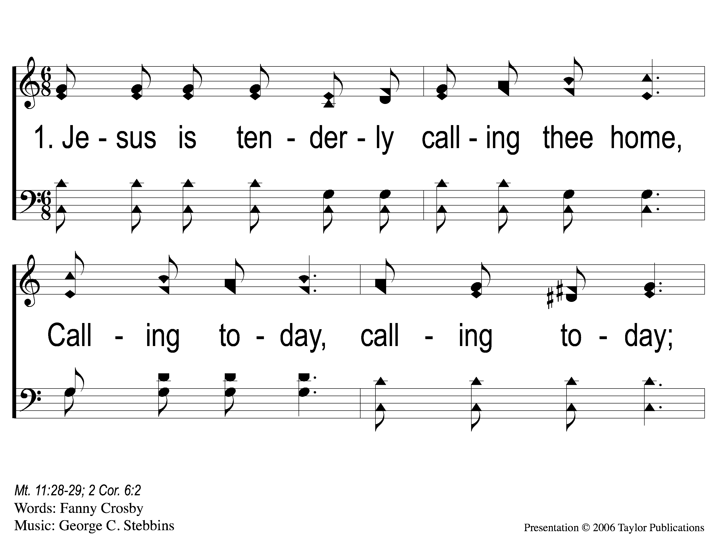
1-1 Jesus is Tenderly Calling
Jesus Is Tenderly Calling
143

Slide 2
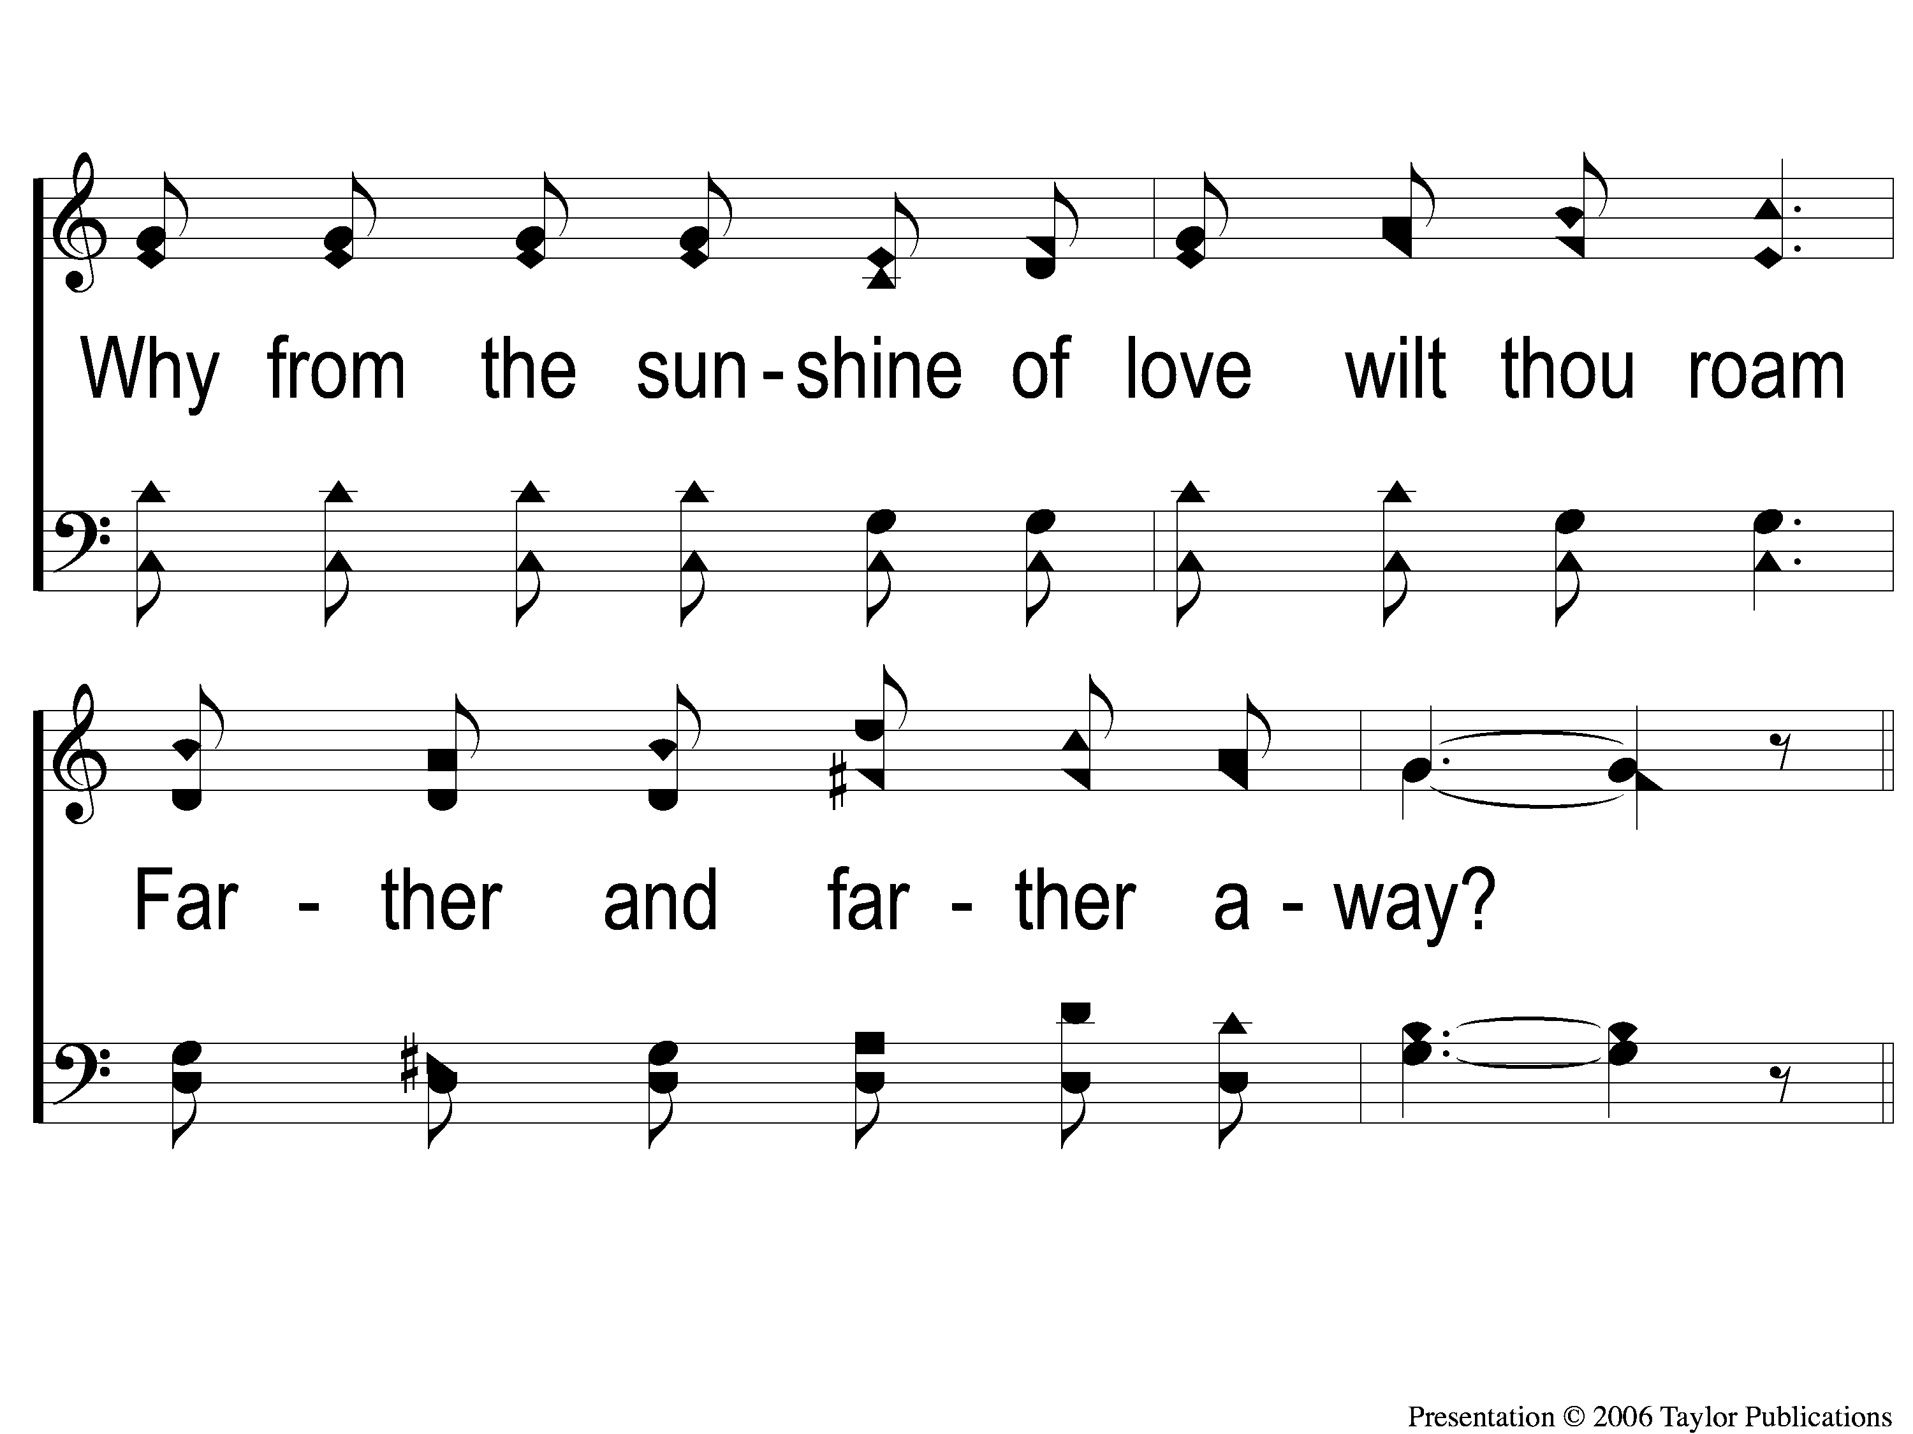
1-2 Jesus is Tenderly Calling
Jesus Is Tenderly Calling
143

Slide 3
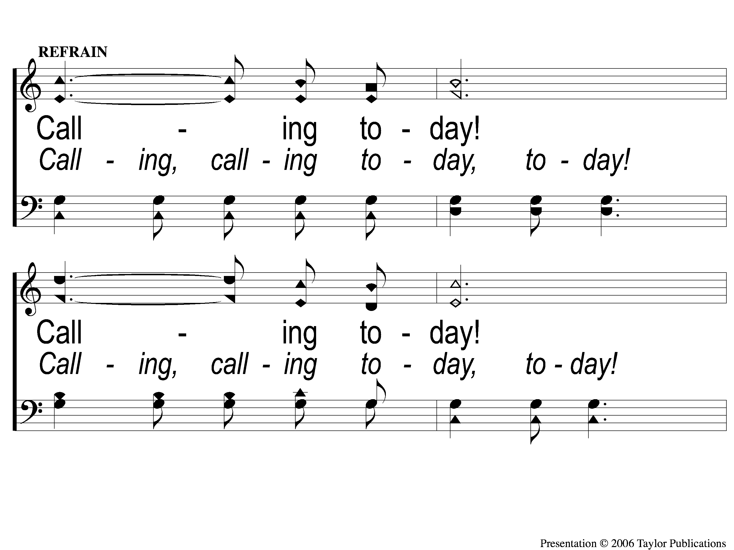
C-1 Jesus is Tenderly Calling
Jesus Is Tenderly Calling
143

Slide 4
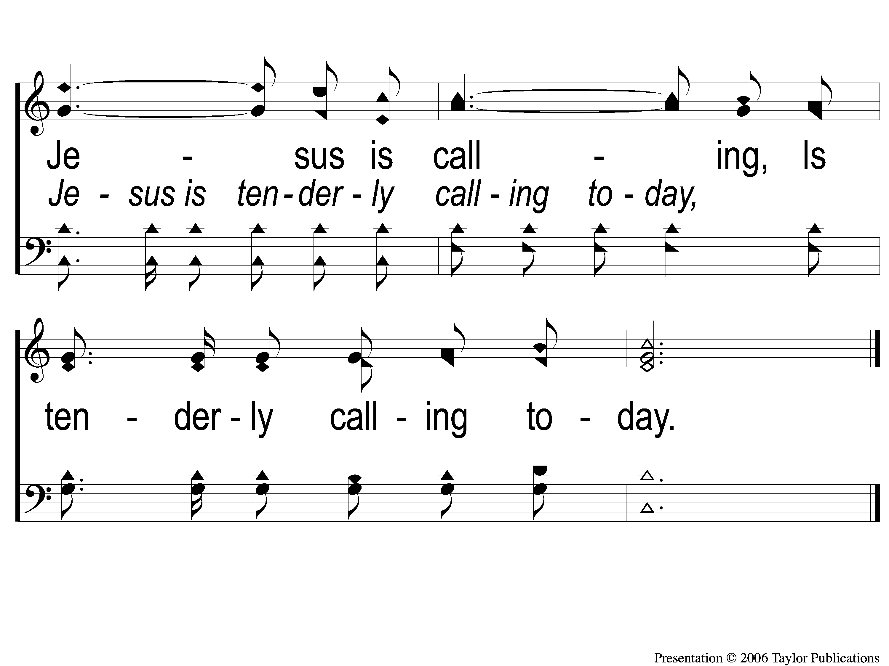
C-2 Jesus is Tenderly Calling
Jesus Is Tenderly Calling
143

Slide 5
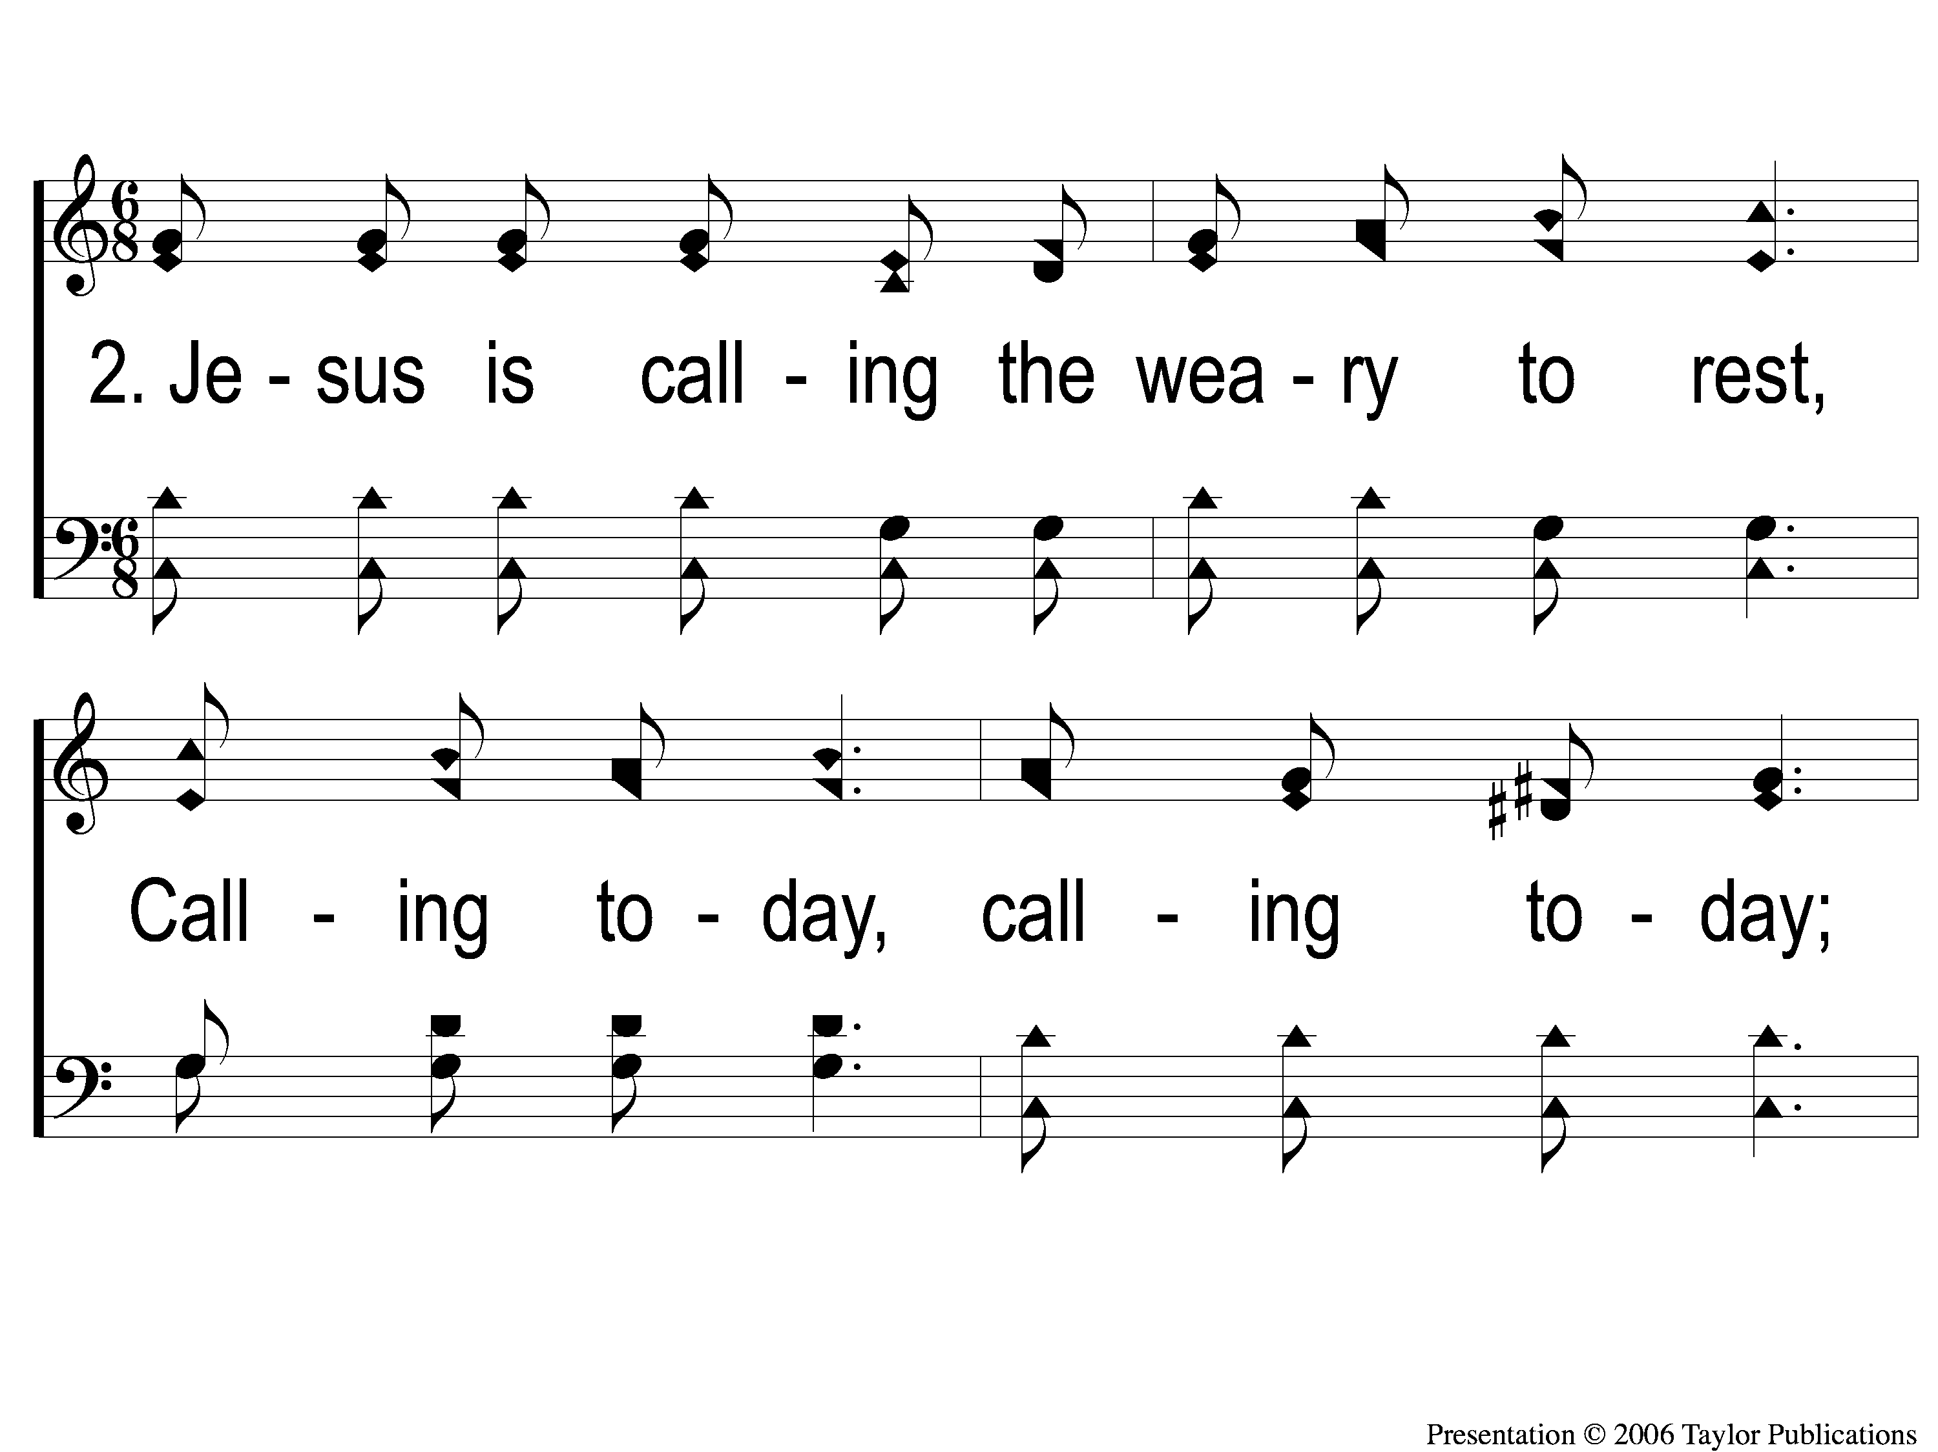
2-1 Jesus is Tenderly Calling
Jesus Is Tenderly Calling
143

Slide 6
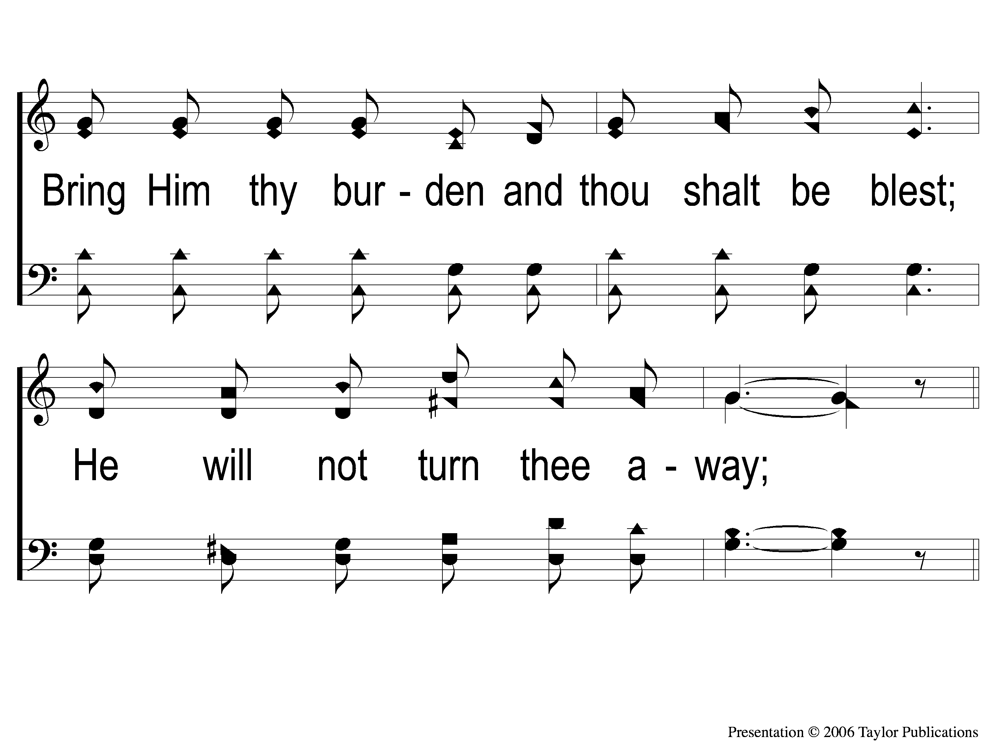
2-2 Jesus is Tenderly Calling
Jesus Is Tenderly Calling
143

Slide 7
C-1 Jesus is Tenderly Calling
Jesus Is Tenderly Calling
143

Slide 8
C-2 Jesus is Tenderly Calling
Jesus Is Tenderly Calling
143

Slide 9
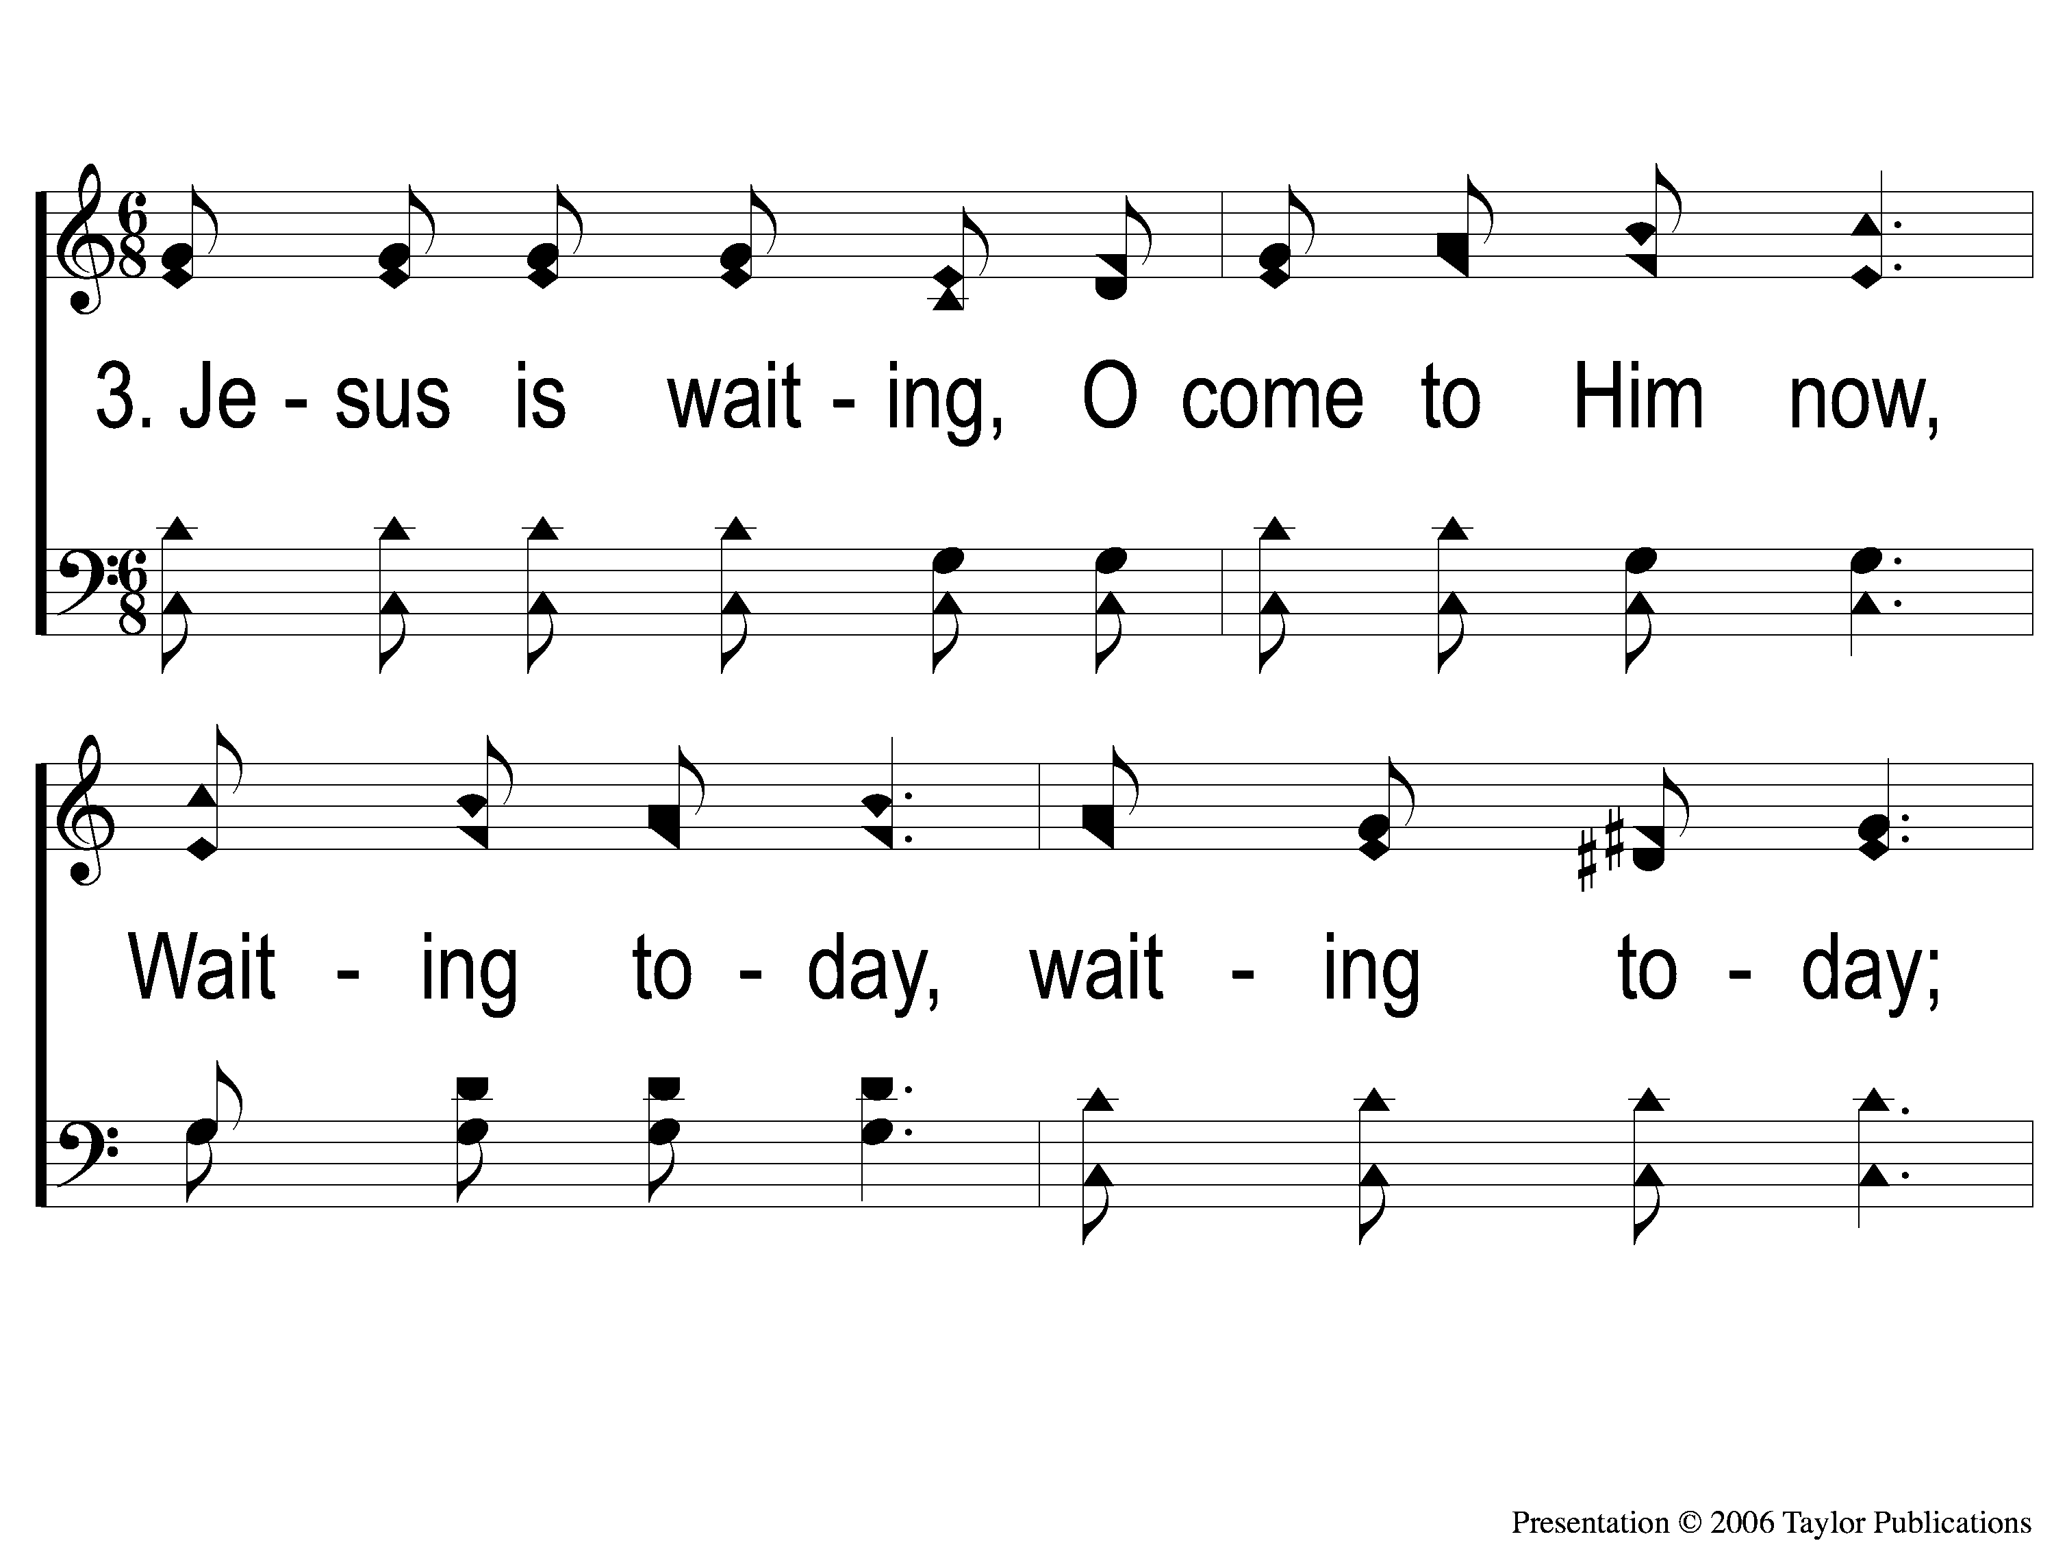
3-1 Jesus is Tenderly Calling
Jesus Is Tenderly Calling
143

Slide 10
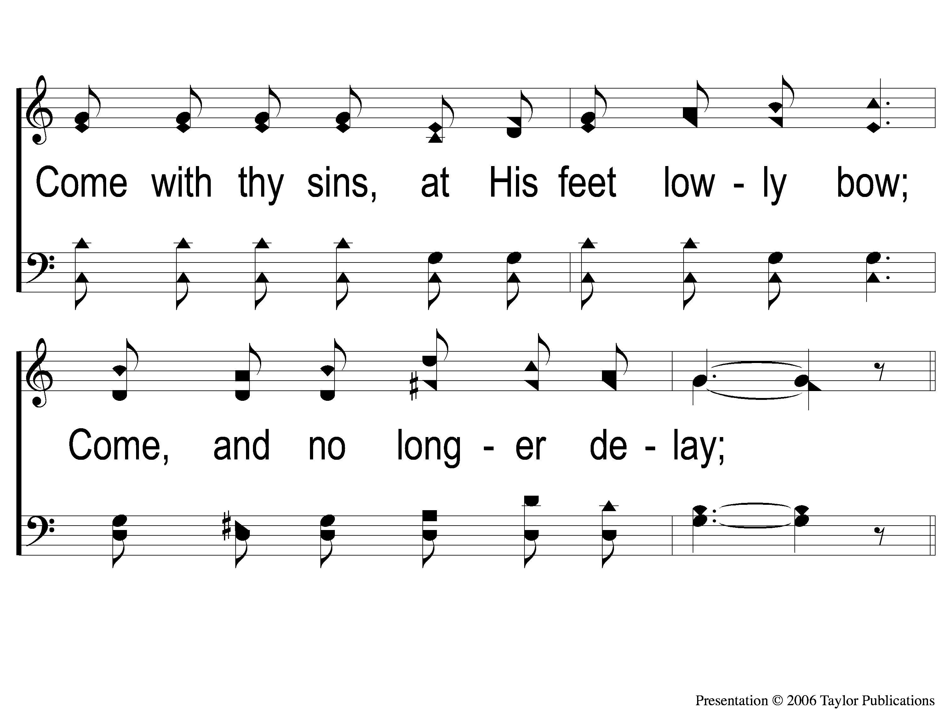
3-2 Jesus is Tenderly Calling
Jesus Is Tenderly Calling
143

Slide 11
C-1 Jesus is Tenderly Calling
Jesus Is Tenderly Calling
143

Slide 12
C-2 Jesus is Tenderly Calling
Jesus Is Tenderly Calling
143

Slide 13
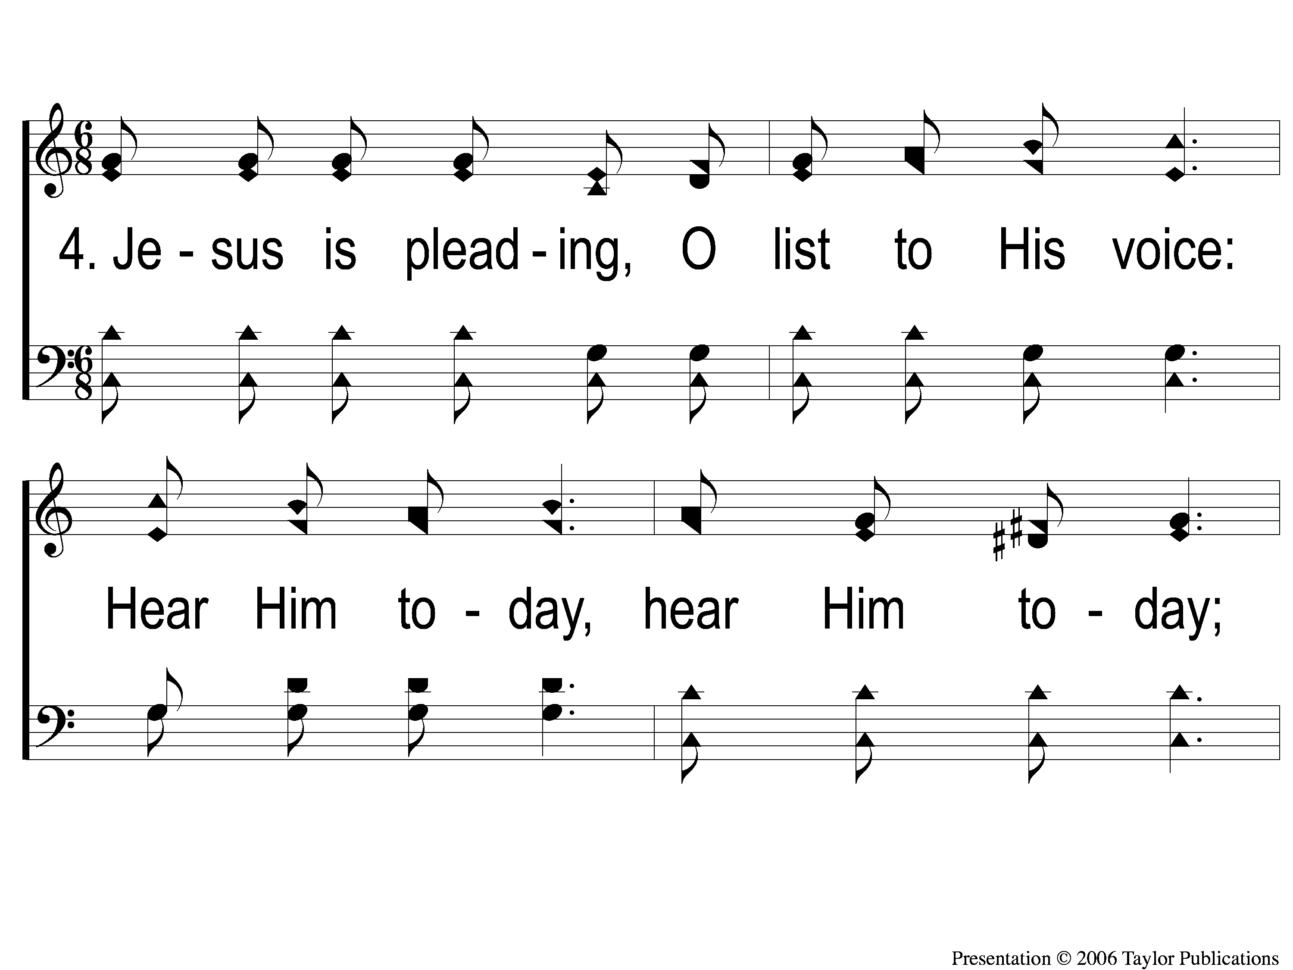
4-1 Jesus is Tenderly Calling
Jesus Is Tenderly Calling
143

Slide 14
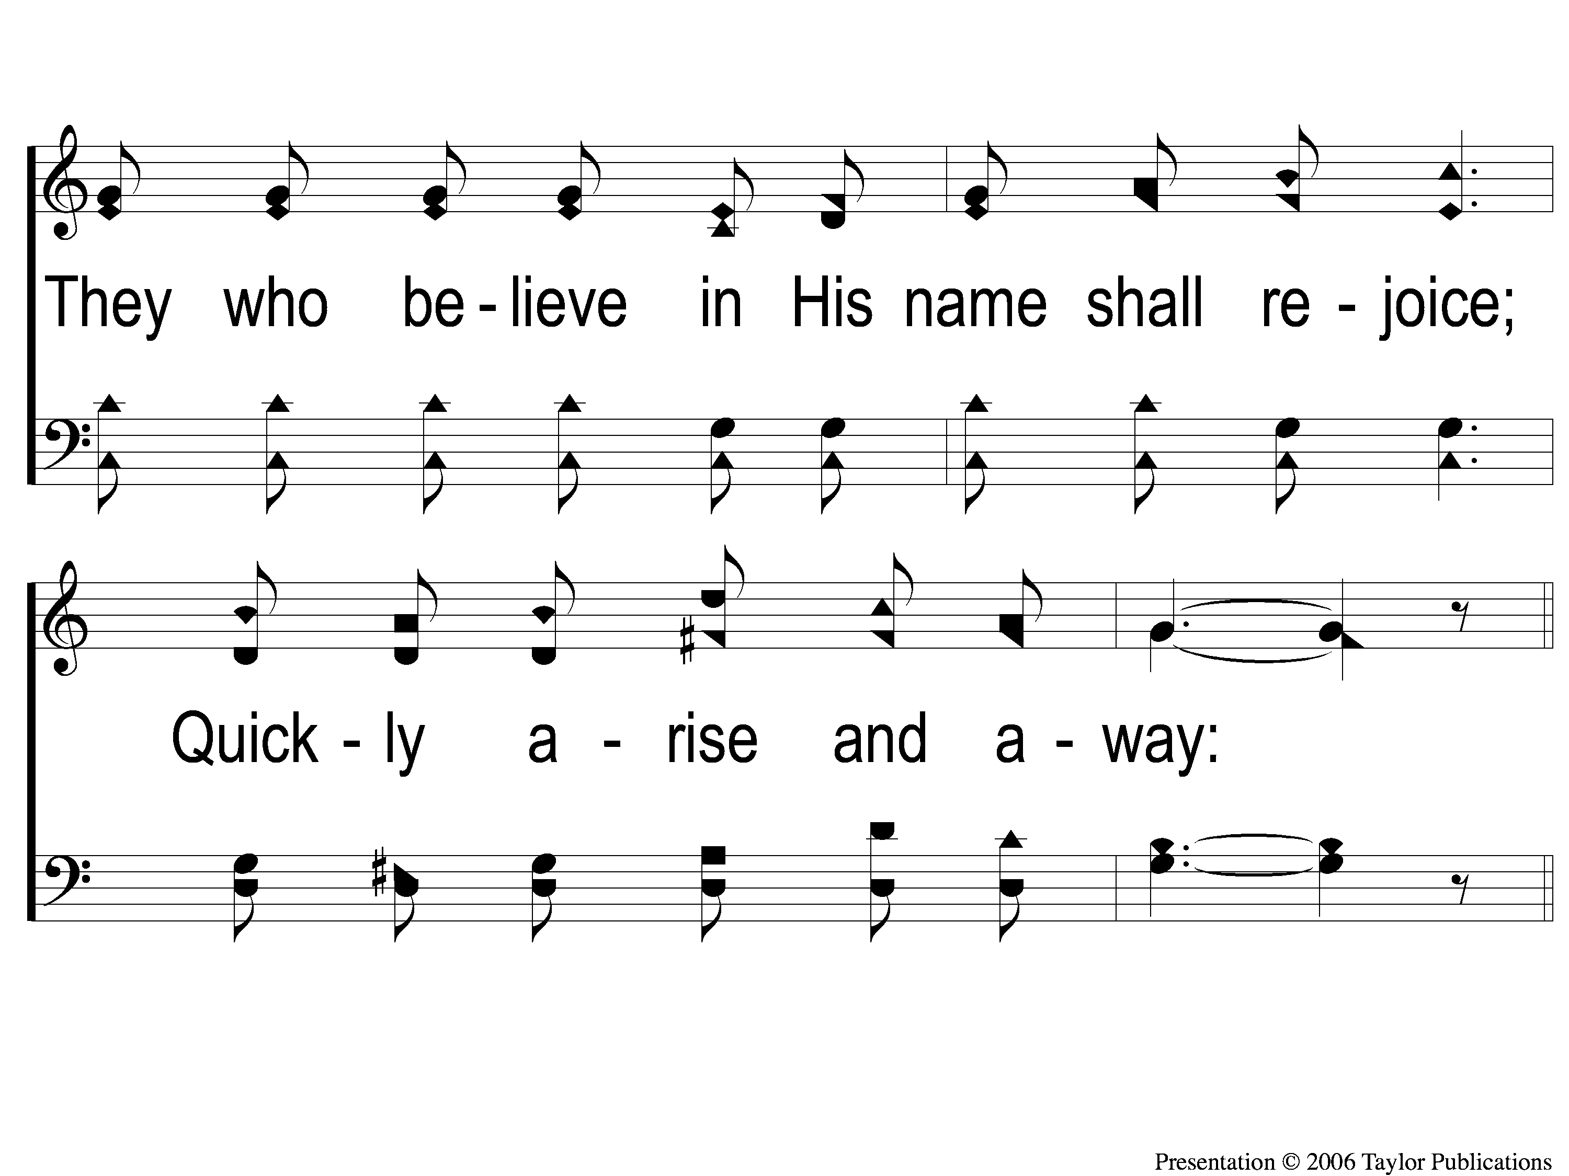
4-2 Jesus is Tenderly Calling
Jesus Is Tenderly Calling
143

Slide 15
C-1 Jesus is Tenderly Calling
Jesus Is Tenderly Calling
143

Slide 16
C-2 Jesus is Tenderly Calling
Jesus Is Tenderly Calling
143

